Slide 1

Drama At Cornwallis Academy
Year 8 – LESSON 3
Lesson Objective:
-To continue to demonstrate an understanding of how show a character
-To begin exploring and devising how to create a Murder Mystery play.
Success Criteria:
Performing and Creating
Level 3
I can sustain a role that I have created for some of the performance. I am more comfortable being led by others in a group situation.
Level 4
I can stay in role for good parts of my performance, occasionally struggling to keep focused. I will make a reasonable contribution to my groups work, sharing some simple ideas.
Level 5
I can stay in role for most of the performance with few distractions. I will make a positive contribution to a group, sharing ideas and showing some leadership.
Level 6
I can consistently stay in role for the whole of the performance. I Contribute ideas very well to the group I’m in and am capable of showing good leadership skills

Slide 2
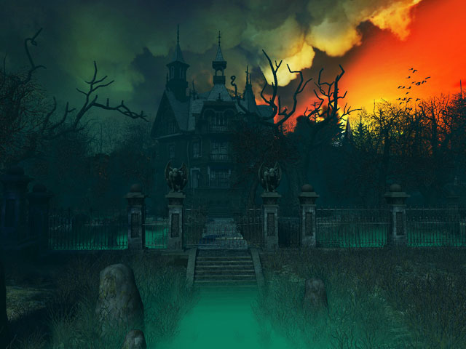
Lesson Objective:
-To continue to demonstrate an understanding of how show a character
- To begin exploring and devising how to create a Murder Mystery play.
Activity 1 – Murder Mystery game 3 – Who is the murderer?
Success Criteria:
Creating and Performing
Level 3
I can sustain a role that I have created for some of the performance. I am more comfortable being led by others in a group situation.
Level 4
I can stay in role for good parts of my performance, occasionally struggling to keep focused. I will make a reasonable contribution to my groups work, sharing some simple ideas.
Level 5
I can stay in role for most of the performance with few distractions. I will make a positive contribution to a group, sharing ideas and showing some leadership.
Level 6
I can consistently stay in role for the whole of the performance. I Contribute ideas very well to the group I’m in and am capable of showing good leadership skills

Slide 3
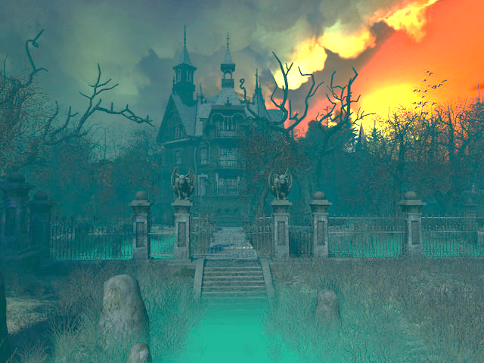
Lesson Objective:
-To continue to demonstrate an understanding of how show a character
- To begin exploring and devising how to create a Murder Mystery play. .
WARM-UP
You will participate in a game called Snake and Friends. You will work in groups of six and six people will go up on stage at a time. You will all then be blind folded. I will then tap one of you on the back which signifies that you are the snake and the rest of you are called Friends. You will then moved into a space. (Stop will signify if someone is about to walk into something). You are to walk about the space and if you come across each other you must whisper in that persons’ ear whether you are a snake of friend. If someone whispers snake then that pupil dies horribly. Keep going until you discover who the snake is. We will continue the game until all pupils have had a turn.
Success Criteria:
Creating and Performing
Level 3
I can sustain a role that I have created for some of the performance. I am more comfortable being led by others in a group situation.
Level 4
I can stay in role for good parts of my performance, occasionally struggling to keep focused. I will make a reasonable contribution to my groups work, sharing some simple ideas.
Level 5
I can stay in role for most of the performance with few distractions. I will make a positive contribution to a group, sharing ideas and showing some leadership.
Level 6
I can consistently stay in role for the whole of the performance. I Contribute ideas very well to the group I’m in and am capable of showing good leadership skills

Slide 4
Lesson Objective:
-To continue to demonstrate an understanding of how show a character
- To begin exploring and devising how to create a Murder Mystery play.
Murder Mystery Assessment
Over the next three lessons you will devise and act out your own Murder Mystery.
What have you learnt about Murder Mysteries so far ?
What are the vital ingredients of a Murder Mystery?
Performing and Creating
Level 3
I can sustain a role that I have created for some of the performance. I am more comfortable being led by others in a group situation.
Level 4
I can stay in role for good parts of my performance, occasionally struggling to keep focused. I will make a reasonable contribution to my groups work, sharing some simple ideas.
Level 5
I can stay in role for most of the performance with few distractions. I will make a positive contribution to a group, sharing ideas and showing some leadership.
Level 6
I can consistently stay in role for the whole of the performance. I Contribute ideas very well to the group I’m in and am capable of showing good leadership skills

Slide 5

Task 1 – Planning a Murder Mystery – Groups based on targets:
As a group you will now need to begin planning and devising your Murder Mystery. Using the Planning question sheet you will need to discuss and make notes on all the key areas highlighted.
Please remember that you are devising a play not writing a story like it says on the sheet, so will need to think about how this will be acted out. (15 minutes)
Lesson Objective:
-To continue to demonstrate an understanding of how show a character
- To begin exploring and devising how to create a Murder Mystery play.
Murder Mystery Assessment
Performing and Creating
Level 3
I can sustain a role that I have created for some of the performance. I am more comfortable being led by others in a group situation.
Level 4
I can stay in role for good parts of my performance, occasionally struggling to keep focused. I will make a reasonable contribution to my groups work, sharing some simple ideas.
Level 5
I can stay in role for most of the performance with few distractions. I will make a positive contribution to a group, sharing ideas and showing some leadership.
Level 6
I can consistently stay in role for the whole of the performance. I Contribute ideas very well to the group I’m in and am capable of showing good leadership skills

Slide 6
Task 2 – Character sheet
Having now fully planned out the story you will need to log the decisions that you have made about each characters involvement. As a group, using the Character sheet, you will need to log each character’s name, motive, alibi and clue that the audience will see. You will also need to think about how these character will be acted. (10 minutes)
Lesson Objective:
-To continue to demonstrate an understanding of how show a character
- To begin exploring and devising how to create a Murder Mystery play.
Murder Mystery Assessment
Performing and Creating
Level 3
I can sustain a role that I have created for some of the performance. I am more comfortable being led by others in a group situation.
Level 4
I can stay in role for good parts of my performance, occasionally struggling to keep focused. I will make a reasonable contribution to my groups work, sharing some simple ideas.
Level 5
I can stay in role for most of the performance with few distractions. I will make a positive contribution to a group, sharing ideas and showing some leadership.
Level 6
I can consistently stay in role for the whole of the performance. I Contribute ideas very well to the group I’m in and am capable of showing good leadership skills

Slide 7
Task 3 –Devising your play
Using your planning sheets you will now devise your Murder Mystery’s. You will have 15 minutes to work on your beginning, middle and end. What performance skills will you need to think about?
Lesson Objective:
-To continue to demonstrate an understanding of how show a character
- To begin exploring and devising how to create a Murder Mystery play.
Murder Mystery Assessment
Performing and Creating
Level 3
I can sustain a role that I have created for some of the performance. I am more comfortable being led by others in a group situation.
Level 4
I can stay in role for good parts of my performance, occasionally struggling to keep focused. I will make a reasonable contribution to my groups work, sharing some simple ideas.
Level 5
I can stay in role for most of the performance with few distractions. I will make a positive contribution to a group, sharing ideas and showing some leadership.
Level 6
I can consistently stay in role for the whole of the performance. I Contribute ideas very well to the group I’m in and am capable of showing good leadership skills

Slide 8
Questions and Answers
Have you managed to fully plan your Murder Mystery?
How can you make your characters really clear and memorable?
What elements will make your plays entertaining?
Lesson Objective
-To continue to demonstrate an understanding of how show a character
- To begin exploring and devising how to create a Murder Mystery play.
Murder Mystery Assessment
Performing and Creating
Level 3
I can sustain a role that I have created for some of the performance. I am more comfortable being led by others in a group situation.
Level 4
I can stay in role for good parts of my performance, occasionally struggling to keep focused. I will make a reasonable contribution to my groups work, sharing some simple ideas.
Level 5
I can stay in role for most of the performance with few distractions. I will make a positive contribution to a group, sharing ideas and showing some leadership.
Level 6
I can consistently stay in role for the whole of the performance. I Contribute ideas very well to the group I’m in and am capable of showing good leadership skills

